Slide 1
HUGO THE SURVIVOR

Slide 2
Project Members
190201003 - Doğu YILDIZ
190201018 - Emre TELLİ
190201032 - Özgür ALAN

Slide 3
AGILE METHODOLOGY
In our Project, we use Agile methodology.
Agile software development is a group of software development methods in which requirements and solutions evolve through collaboration between self-organizing, cross-functional teams. It promotes adaptive planning, evolutionary development, early delivery, continuous improvement, and encourages rapid and flexible response to change.

Slide 4
Principles of Agile
Individuals and interactions over processes and tools
Working software over comprehensive documentation
Customer collaboration over contract negotiation
Responding to change over following a plan

Slide 5
SPRINT 1
We planned how to make the our game. We decided which game engine will be used.
Moreover, we chose the character how looks like. We specified the main rules of the game.
After studies, we decided to use unity 3d game engine.

Slide 6
WHAT IS UNITY?
Unity is a game engine that has a platform for creating games and is compatible with other platforms.
There are three parts in Unity :
-Design
-Scripting(Coding Part)
-Modelling Animation: This part can be formed in different platforms and can be imported to Unity. For example; Maya, Blender
With Unity, we can create a game for lots of platforms such as Android, PC, WEB, iOS.

Slide 7
The Parts of the UNITY
Scene and Game:
The game panel is that the everything that cameras scan. It means game screen. When we finish the game and publish it, users will see this scene.
Project and Hierarchy:
All the game objects take part in the hierarchy panel and can be controlled from this. In the Project panel, all the things about the game are stored.

Slide 8
The Parts of the UNITY-2
Inspector:
We can reach all the information about any object in this panel. This information include components and transform information of the object.
Console Panel:
This panel is the part that gives the warning and error messages.

Slide 9
The Operands of UNITY
Game Object:
All the objects in the game. We can use the components to give the features to these objects.
These components can be a script, a sound source and physical appearances.
Transform Component:
This is a default component that includes the information about position, rotation and dimension.

Slide 10
SPRINT 2
We did the some researches about Unity background process.
We designed the character and background.

Slide 11
Background of the Unity Framework
In computer systems, a framework is often a layered structure indicating what kind of programs can or should be built and how they would interrelate. Some computer system frameworks also include actual programs, specify programming interfaces, or offer programming tools for using the frameworks.

Slide 12
Perspective Camera Class
Recap:
Our camera is going to be where all our rendering happens, exclusively; its going to cull all of our objects to the screen, and it is also going to manage a list of all of our points.

Slide 13
London Culling:
For our game engine, the small selection that we take will be the points that we want to draw to the screen. The larger group of objects will be every point that exists.
Our view space will be defined across all three of the traditional axes: x, y, and z. Its x definition will consist of everything between the window's left and right boundaries, its y definition will consist of everything between the window's top and bottom boundaries, and its z definition will be between 0 (where the camera is set) and our player's view distance (for our demonstration, we will be using an arbitrary value of 100).
Prior to drawing a point, our camera class is going to check to see whether that point lies within our view space. If it does, then the point will be drawn; otherwise, it will not.

Slide 14
We have our camera handle all of the rendering for our engine as well. Depending on the engine, you will find that renderers are often separated from the camera systems. This is typically done to keep the systems encapsulated nicely, since - depending on the scope of your engine - the two could get quite messy if kept together. For our purposes, though, it will be simpler to treat them as one.
First, we're going to want a function that can be called externally from the class that will draw the scene. This function will cycle through each of the points that exist, compare them to the camera's culling parameters, and draw them if applicable.

Slide 15
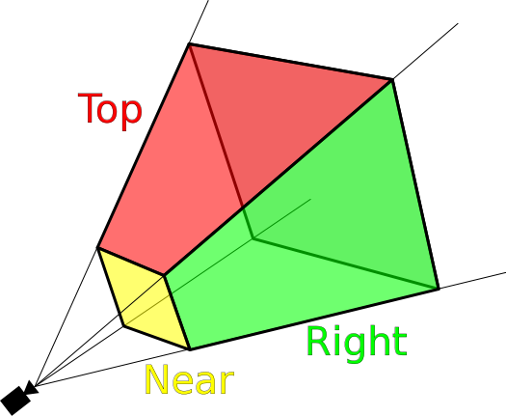

Slide 16
Point Management:
The final piece of our camera class is going to be its point management system. Depending on the programming language you are using, this could just be a simple array of all of the objects that can be drawn (we will be handling more than just points in later parts). Alternatively, you may have to use the language's default object parent class. If you are super unlucky, you will have to create your own object parent class and have each drawable class (so far only points) be a child of that class.

Slide 17
As a result;
With a camera and rendering system under your belt, you can technically say that you've created a 3D game engine! It may not be overly impressive just yet, but it's on its way.

Slide 18
The Technique of the Collider
Each game object has shape and transform.Colliders define that any objects collided.When their transforms are overlap, it means that when the difference of the positions of objects is zero then physic engine decide that they are collided and call the pre-build collision functions.
We used onTriggerEnter collision function to determine collisions between character and coins.

Slide 19
SPRINT 3
We handled the coding part according to our plan and our design.
We wrote the functions about game like movement functions and collision functions.
We designed the interface like main menu,pause menu with time scale variable.When we push the pause button,time scale will be zero, it means the elapsing time in the game will stop.

